Slide 1
Programming with ARDUINO https://sites.google.com/thapar.edu/buggy/home

Slide 2
Arduino Programming Basics

Slide 3
Comments
  Comments can be anywhere
  Comments created with // or /* and */
  Comments do not affect code
  You may not need comments, but think about the community!

Slide 4
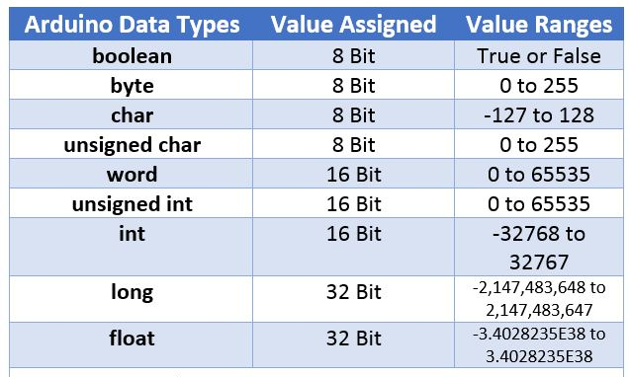
Variables

Slide 5
Declaring Variables
  Boolean: boolean variableName;
  Integer: int variableName;
  Character: char variableName;
  String: stringName [ ];

Slide 6
Assigning Variables
  Boolean: variableName = true;
  or variableName = false;
  Integer: variableName = 32767;
  or variableName = -32768;
  Character: variableName = ‘A’;
  or stringName = “SparkFun”;

Slide 7
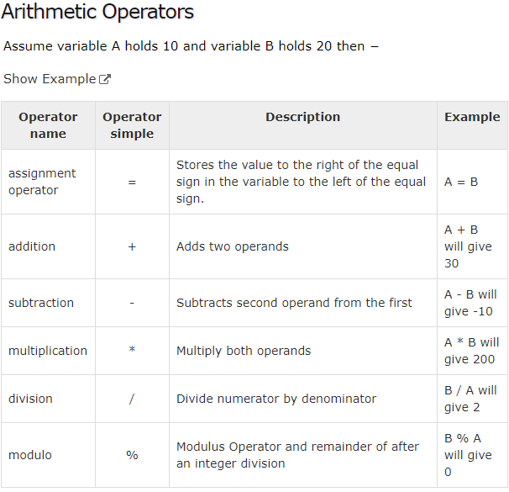

Slide 8
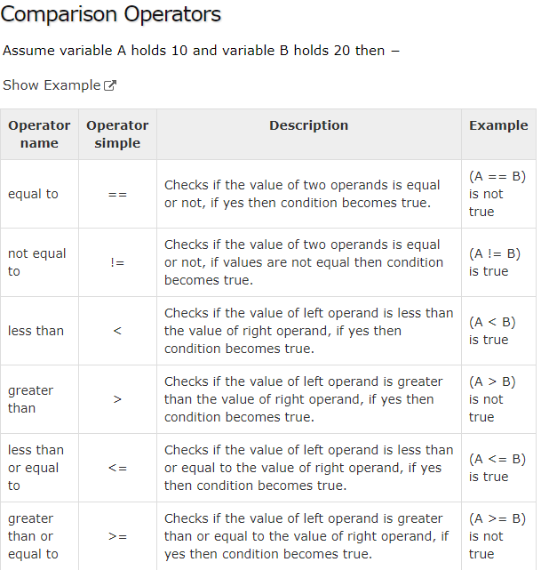

Slide 9
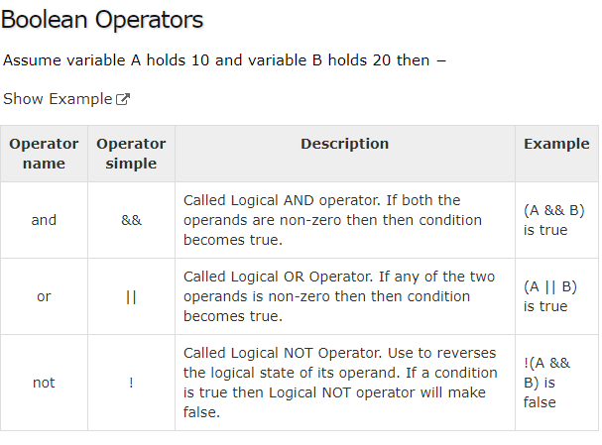

Slide 10
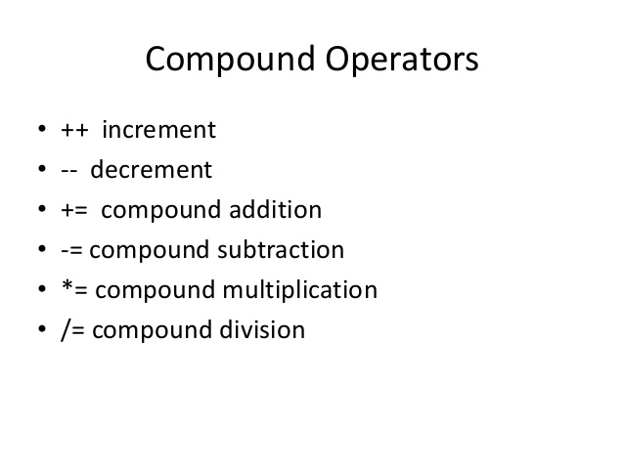

Slide 11
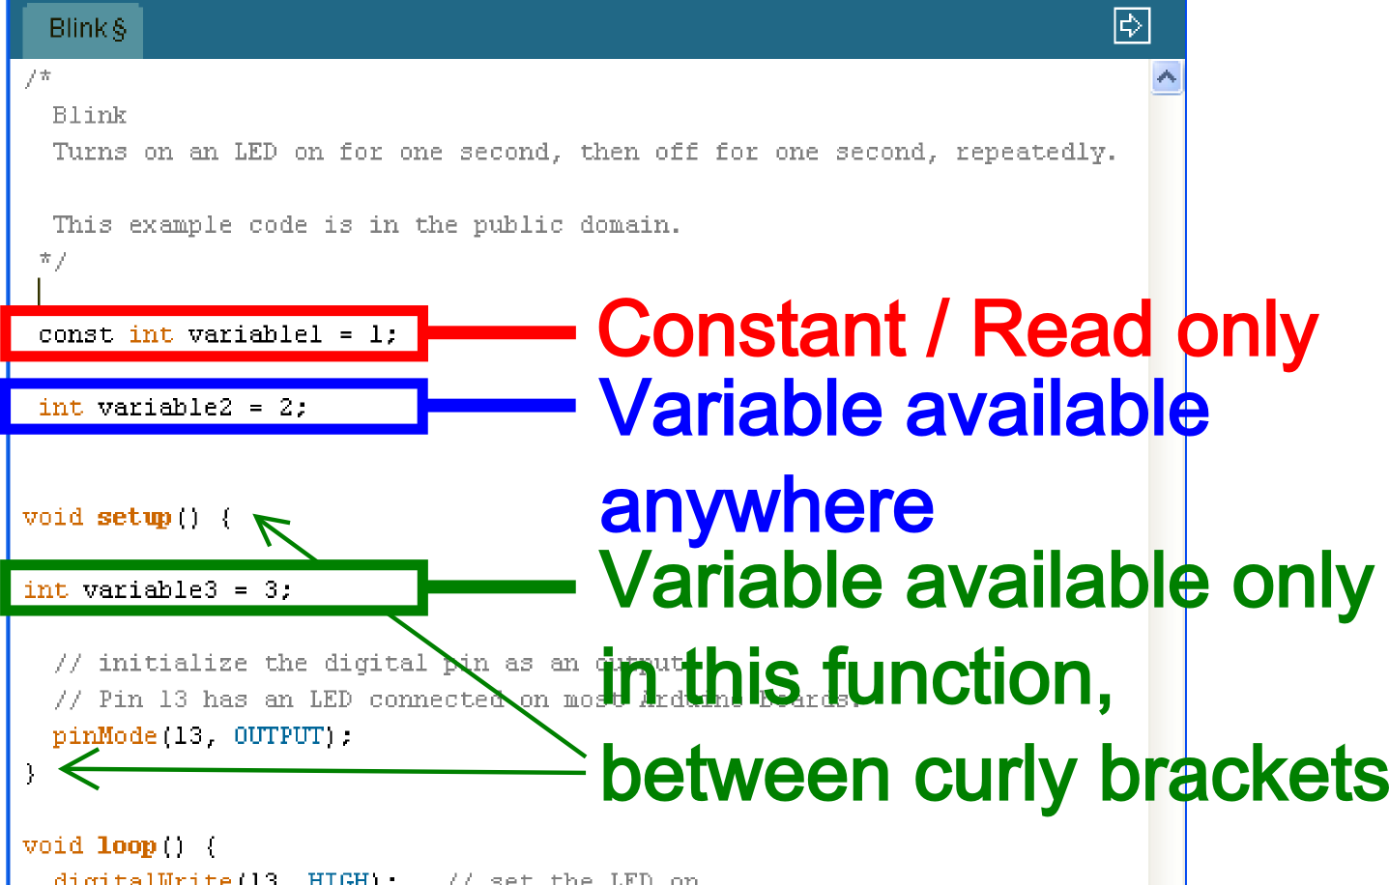
Variable Scope
Where you declare your variables matters

Slide 12
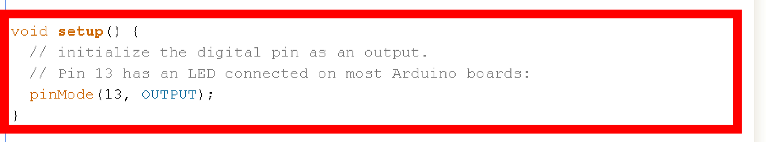
Setup void setup ( ) { }
The setup function comes before
the loop function and is necessary
for all Arduino sketches

Slide 13
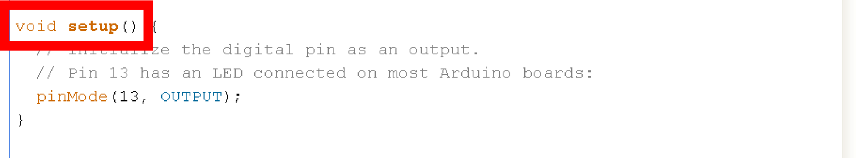
Setup void setup ( ) { }
The setup header will never change,
everything else that occurs in setup
happens inside the curly brackets

Slide 14
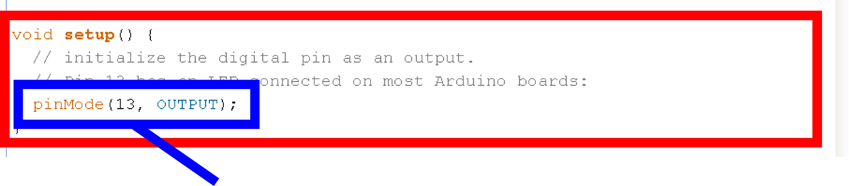
Setup void setup ( ) { pinMode (13, OUTPUT); }
Outputs are declare in setup, this is done by using the pinMode function
This particular example declares digital pin # 13 as an output, remember to use CAPS

Slide 15
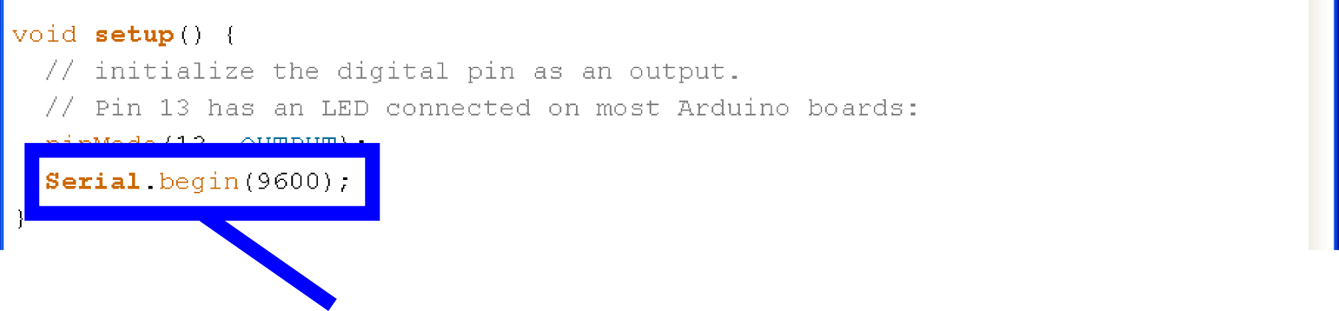
Setup void setup ( ) { Serial.begin;}
Serial communication also begins in setup
This particular example declares Serial communication at a baud rate of 9600.

Slide 16
Setup, Internal Pullup Resistors void setup ( ) { digitalWrite (12, HIGH); }
You can also create internal pullup resistors in setup, to do so digitalWrite the pin HIGH
This takes the place of the pullup resistors currently on your circuit 7 buttons

Slide 17
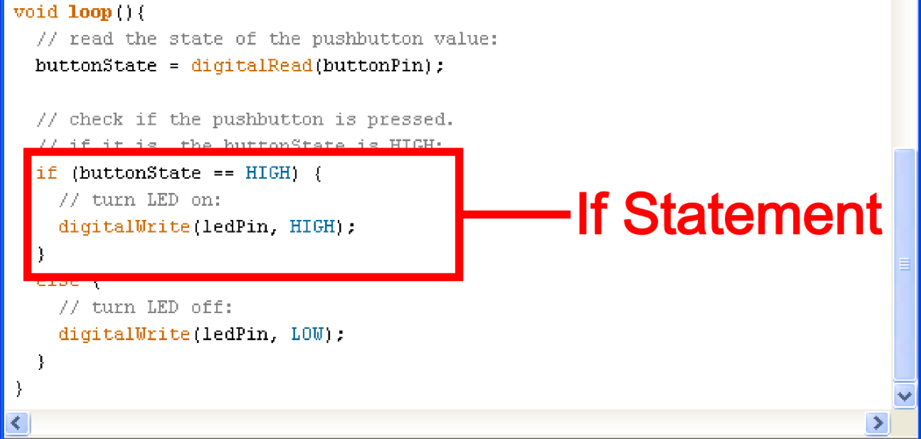
If Statements
if ( this is true ) { do this; }

Slide 18
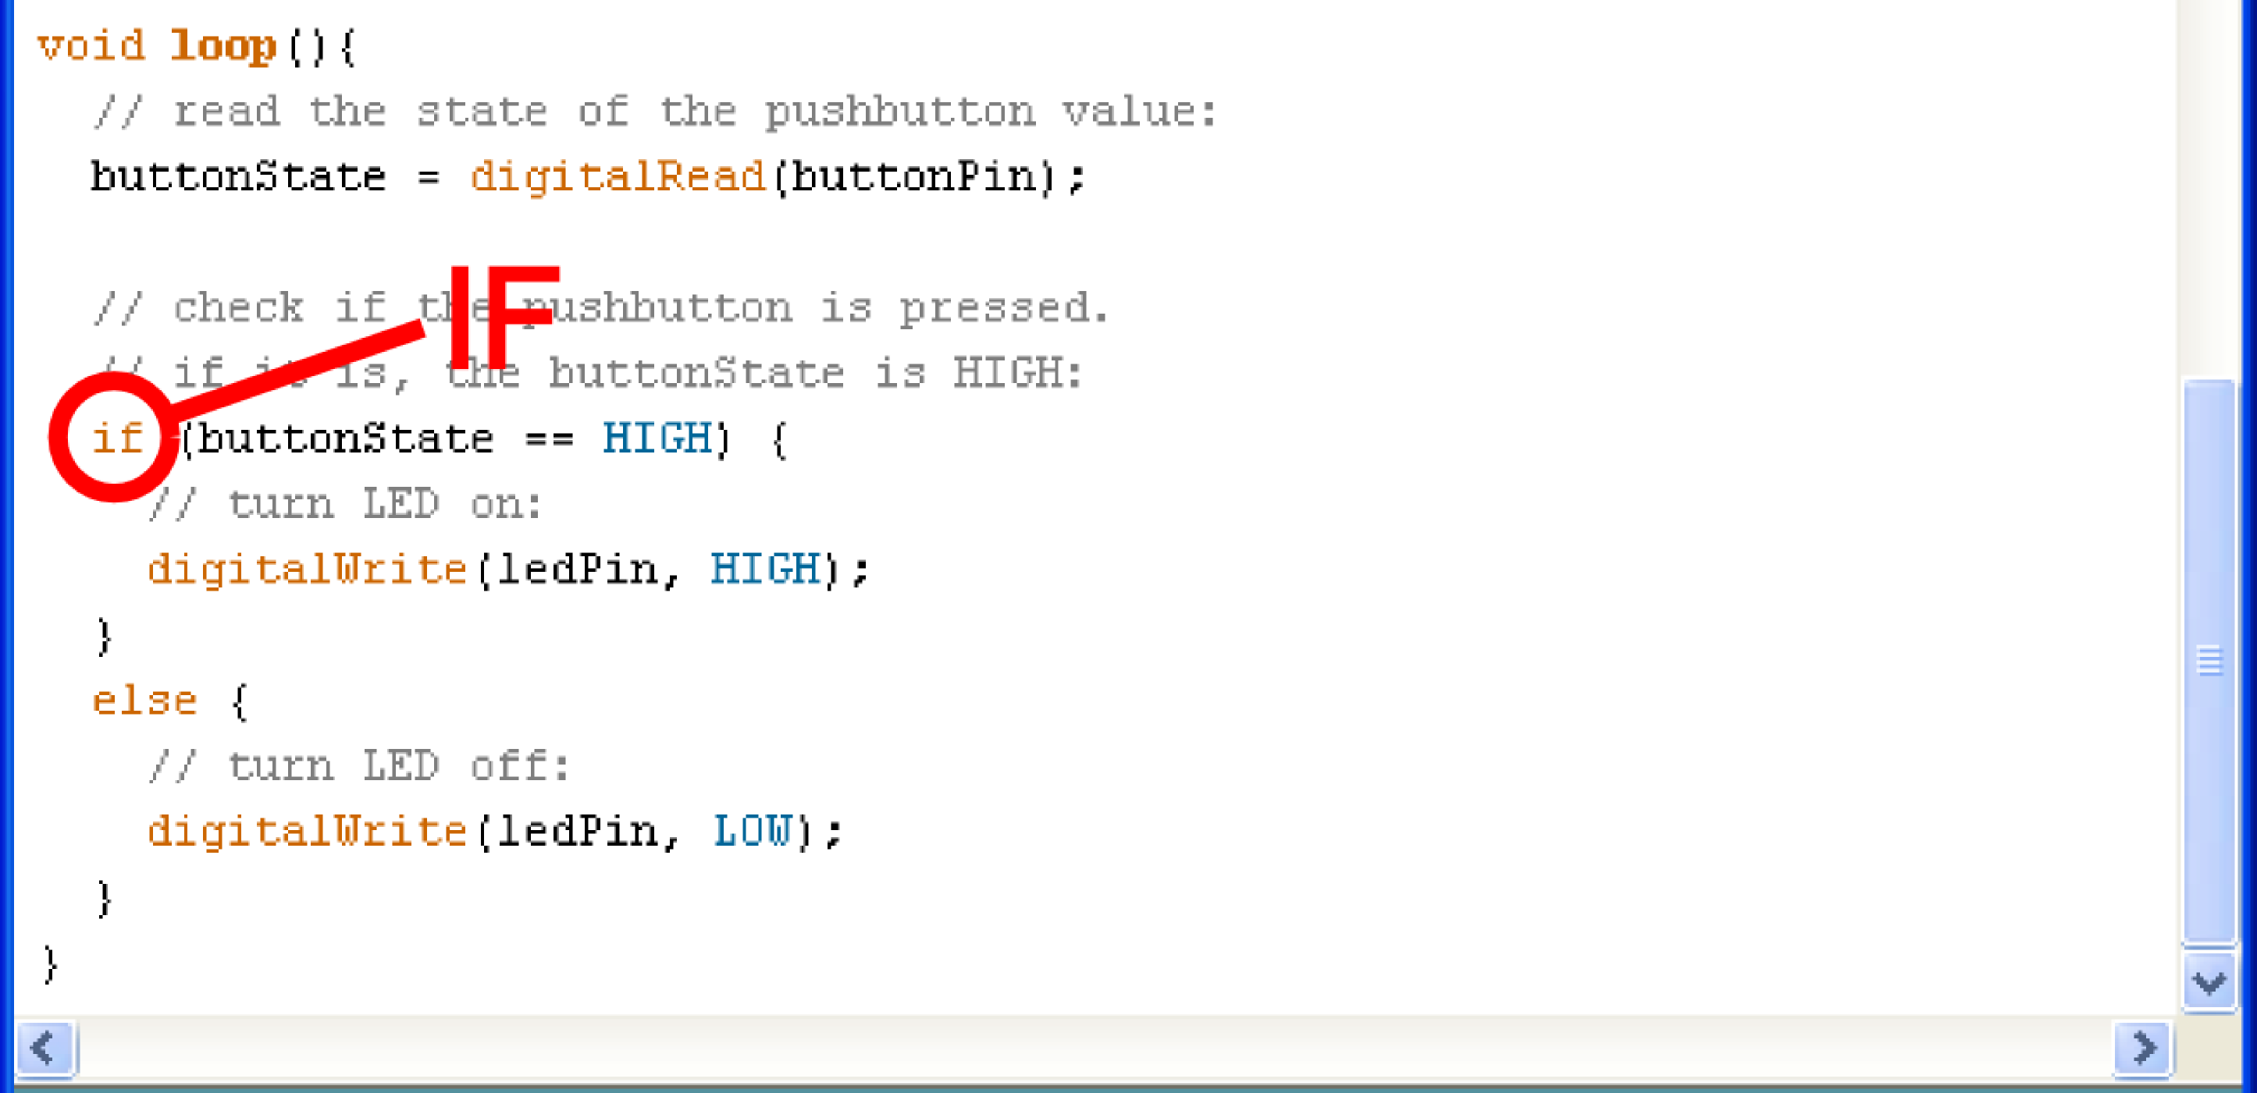
If
if ( this is true ) { do this; }

Slide 19
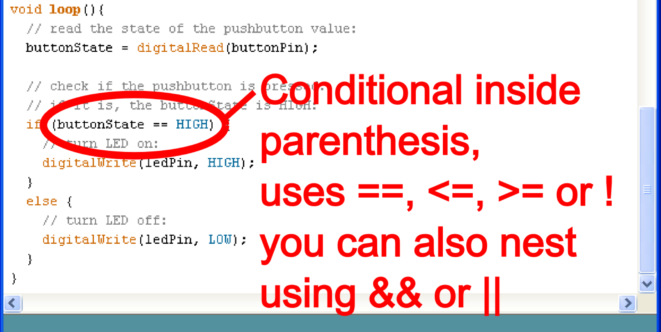
Conditional
if ( this is true ) { do this; }

Slide 20
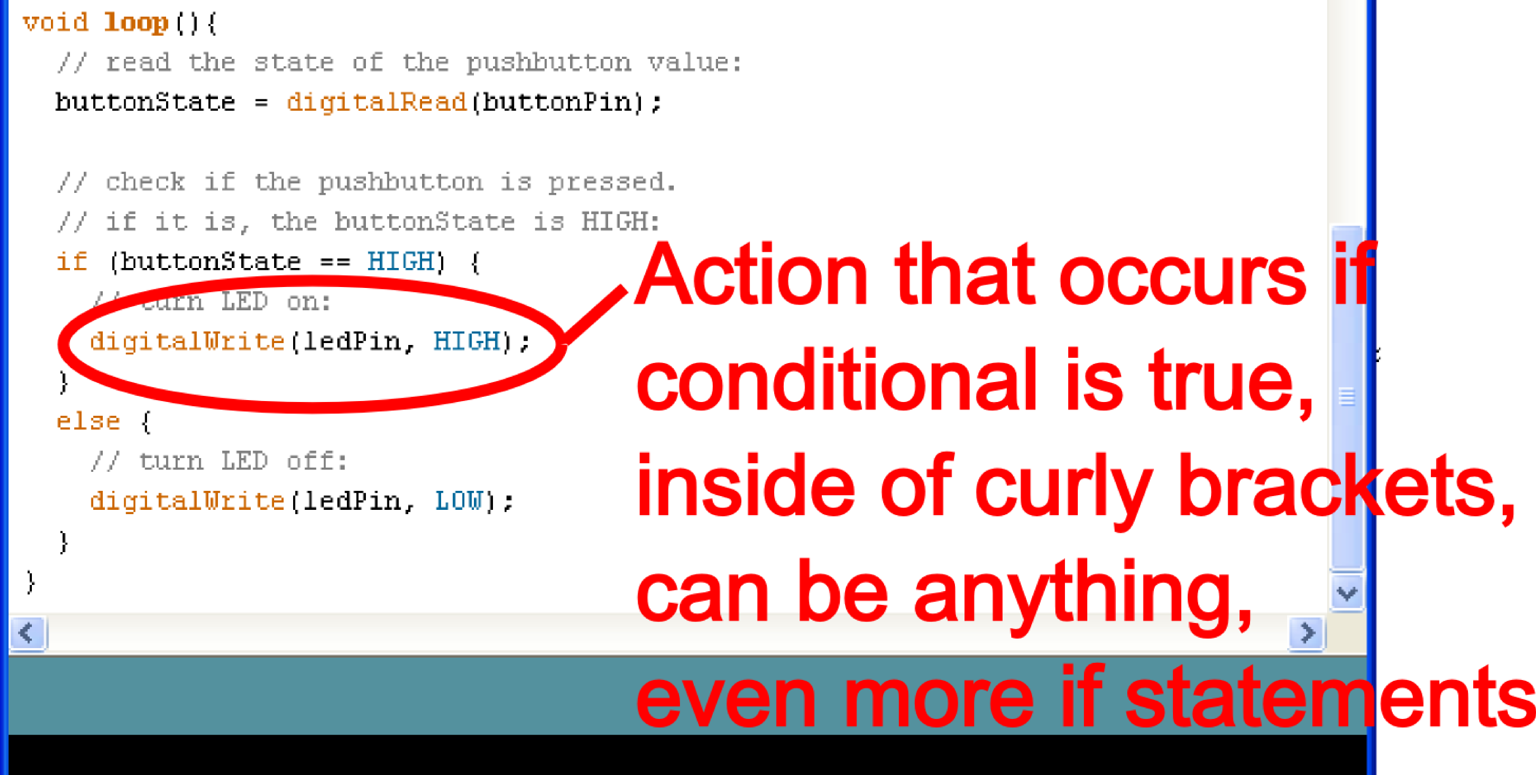
Action
if ( this is true ) { do this; }

Slide 21
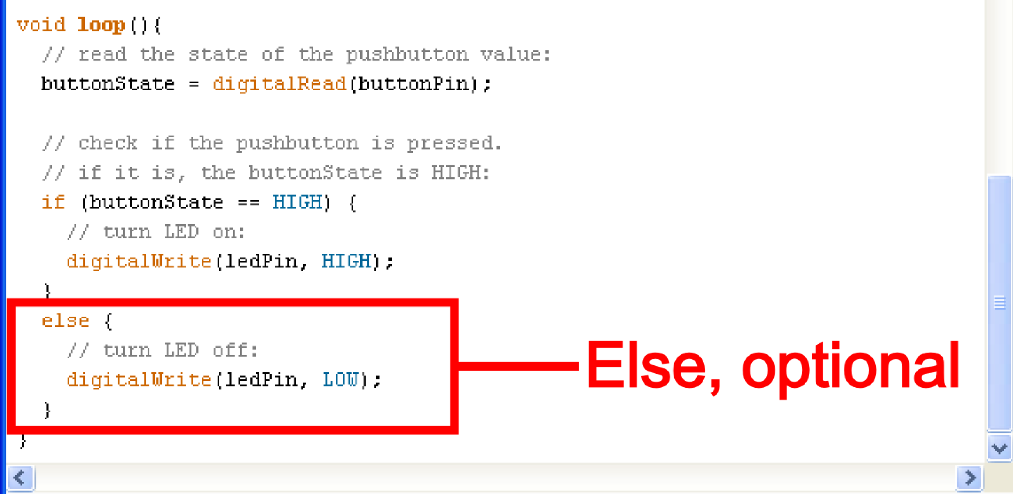
Else
else { do this; }

Slide 22
Basic Repetition
loop
For
while

Slide 23
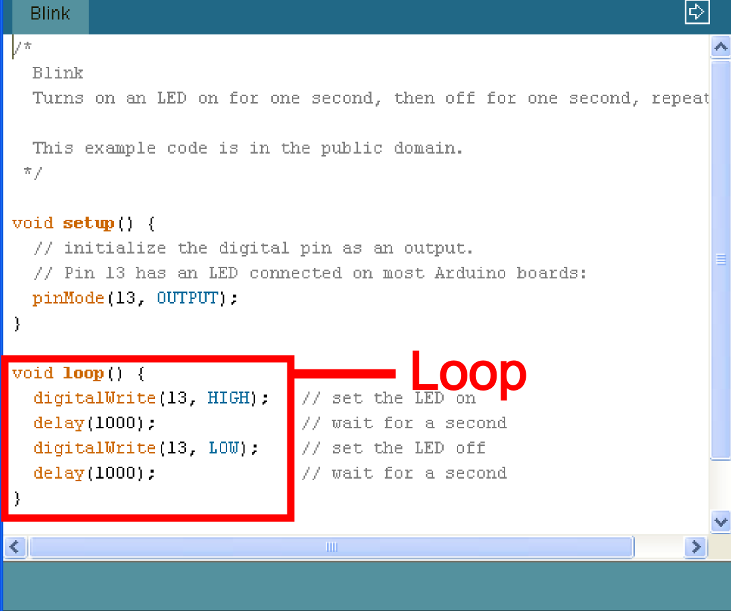
Basic Repetition
void loop ( ) { }

Slide 24
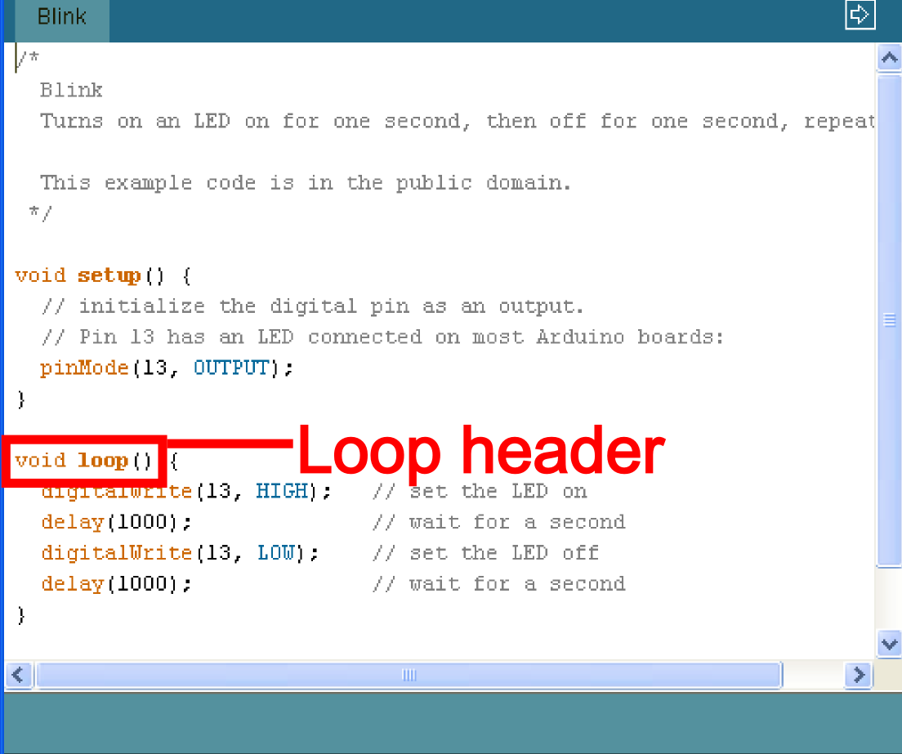
Basic Repetition
void loop ( ) { }

Slide 25
Basic Repetition
void loop ( ) { }
The “void” in the header is what the function will return. In this case it returns nothing so it is void

Slide 26
Basic Repetition
void loop ( ) { }
The “loop” in the header is what the function is called, sometimes you make the name up, sometimes (like loop) the function already has a name

Slide 27
Basic Repetition
void loop ( ) { }
The “( )” in the header is where you declare any variables that you are “passing” (or sending) the function, the loop function is never “passed” any variables

Slide 28
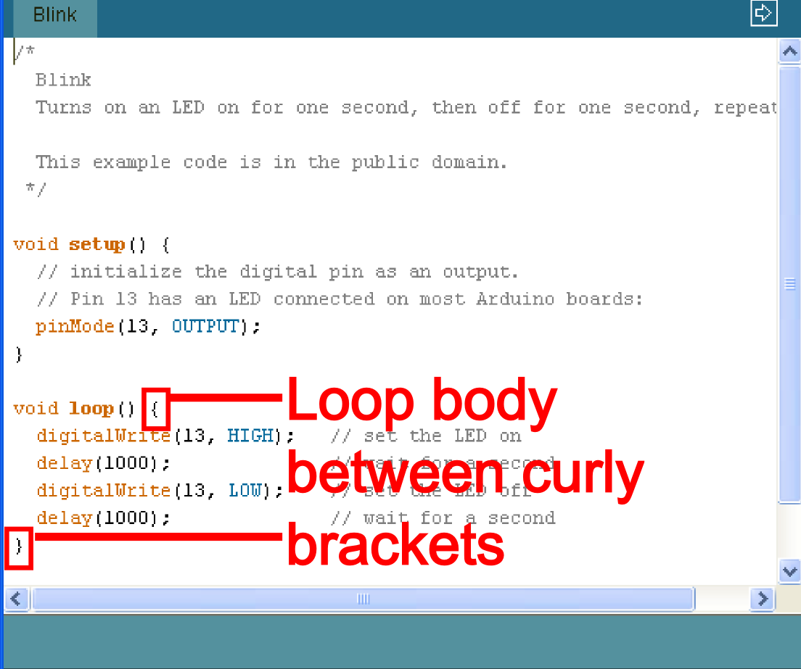
Basic Repetition
void loop ( ) { }

Slide 29
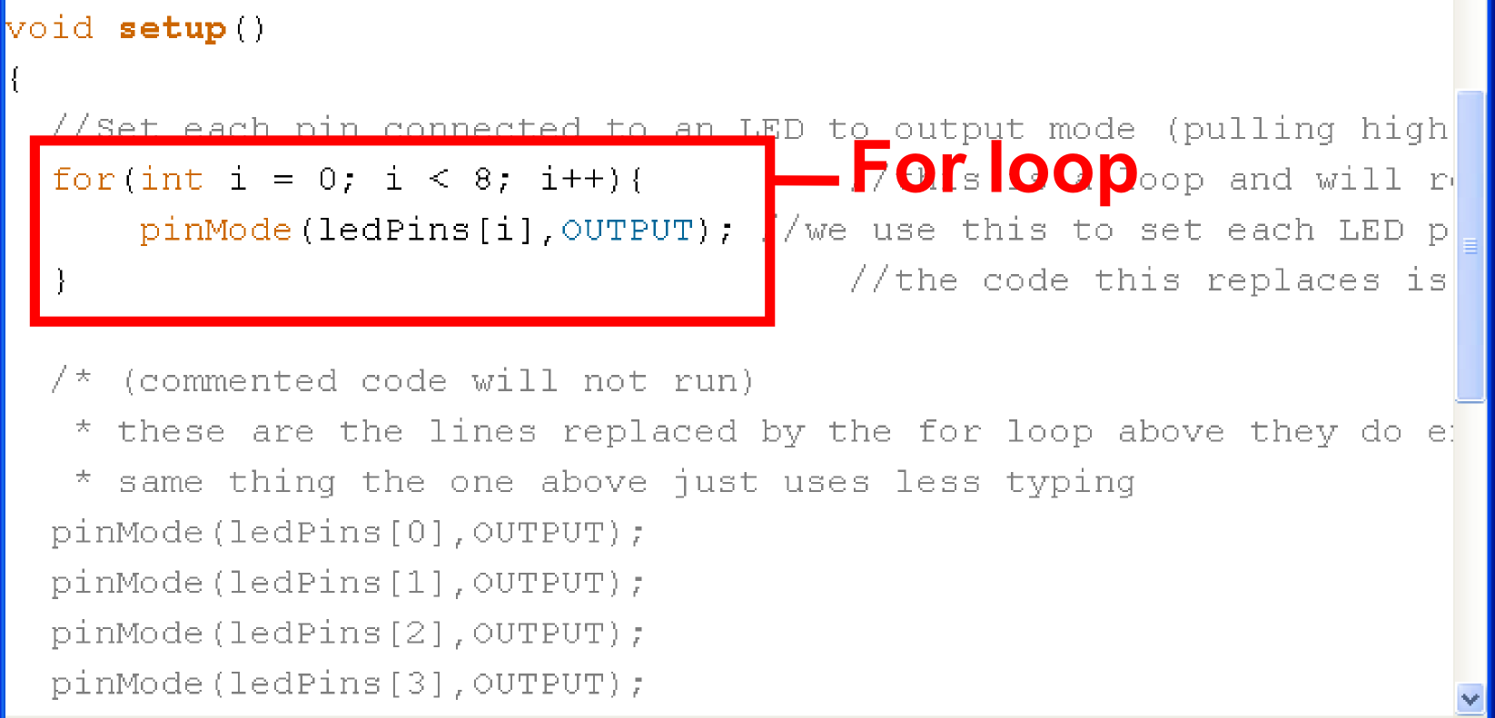
Basic Repetition
for (int count = 0; count<10; count++)
{
//for action code goes here
//this could be anything
}

Slide 30
Basic Repetition
while ( count<10 )
{
//while action code goes here
//should include a way to change count
//variable so the computer is not stuck
//inside the while loop forever
}

Slide 31
Basic Repetition
while ( count<10 )
{
//looks basically like a “for” loop
//except the variable is declared before
//and incremented inside the while
//loop
}

Slide 32
Basic Repetition
Or maybe:
while ( digitalRead(buttonPin)==1 )
{
//instead of changing a variable
//you just read a pin so the computer
//exits when you press a button
//or a sensor is tripped
}

Slide 33
Important functions
Serial.println(value);
  Prints the value to the Serial Monitor on your computer
pinMode(pin, mode);
  Configures a digital pin to read (input) or write (output) a digital value
digitalRead(pin);
  Reads a digital value (HIGH or LOW) on a pin set for input
digitalWrite(pin, value);
  Writes the digital value (HIGH or LOW) to a pin set for output

Slide 34
Using LEDs
void setup()
{
pinMode(13, OUTPUT); //configure pin 13 as output
}
// blink an LED once
void blink1()
{
digitalWrite(13,HIGH); // turn the LED on
delay(500); // wait 500 milliseconds
digitalWrite(13,LOW); // turn the LED off
delay(500); // wait 500 milliseconds
}

Slide 35
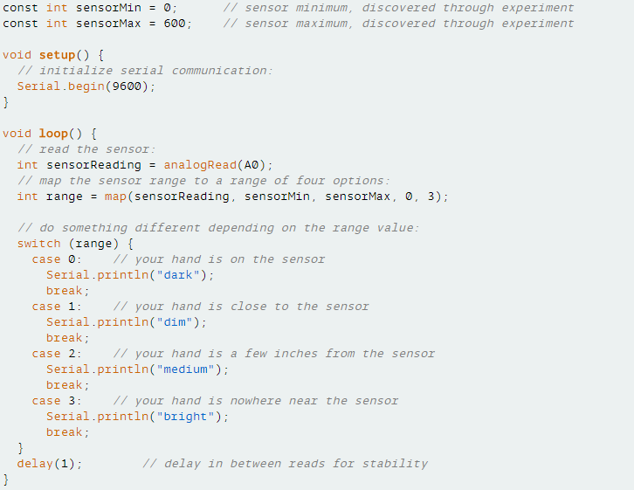
Switch Case

Slide 36
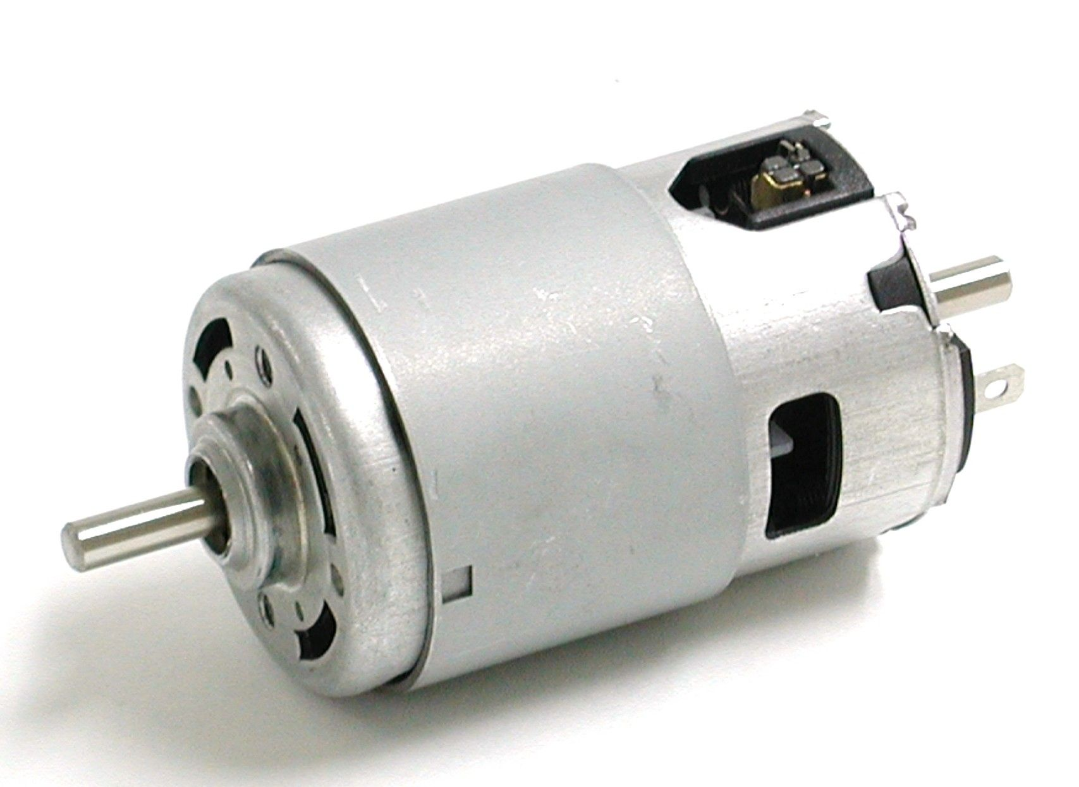
DC MOTORS AND ACTUATORS

Slide 37
Actuators
An electric motor is an electrical machine that converts electrical energy into mechanical energy.
Actuator: Device that turns energy (typically electrical) to motion
Features
  Force
  Speed
  Torque
  Efficiency

Slide 38
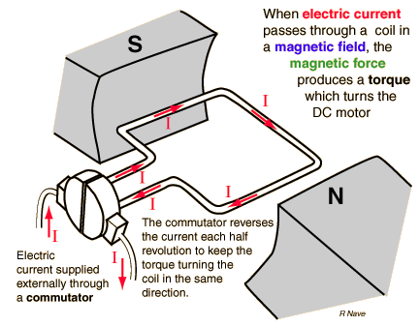
DC motor
Force is produced due to the electric current in a wire inside a magnetic field.
Proportional to the current, therefore can be controlled by potentiometer
Hard to control precisely

Slide 39
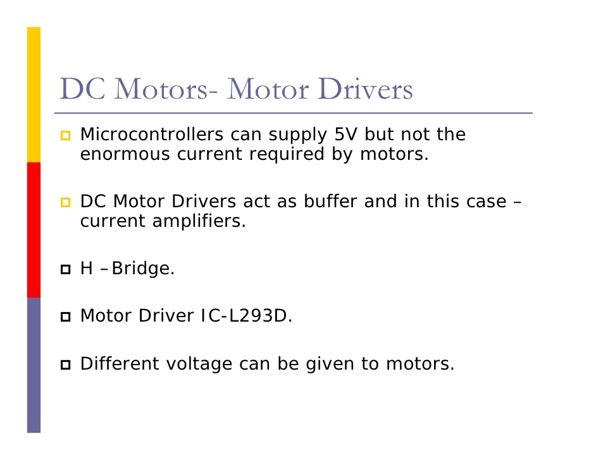

Slide 40
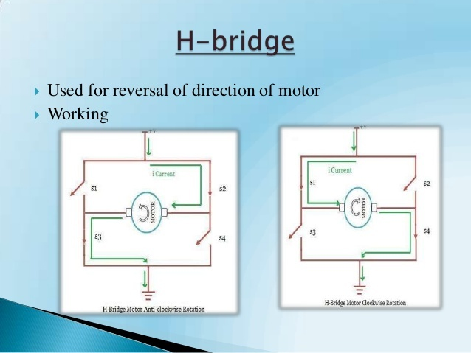

Slide 41
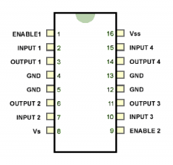
DC motor Driver/ H bridge IC/ L293D

Slide 42
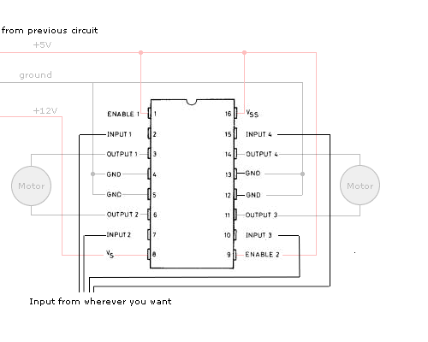
H bridge connection with arduino

Slide 43
Buggy Motor Code
void setup()
{
pinMode(5, OUTPUT); // Right +ve)
pinMode(6, OUTPUT); // Right -ve
pinMode(7, OUTPUT); // Left -ve
pinMode(8, OUTPUT); // Left +ve
}
void forward()
{
digitalWrite(5,HIGH); digitalWrite(6,LOW); digitalWrite(7,LOW);
digitalWrite(8,HIGH);
}
void Backward()
{
digitalWrite(5,LOW);
digitalWrite(6,HIGH);
digitalWrite(7,HIGH);
digitalWrite(8,LOW);
}
void loop()
{
forward();
delay(3000); // wait for 3 second
Backward();
delay(3000); // wait for 3 second
}

Slide 44
Serial Communications
Serial.begin(9600)
Serial.print()
Serial.println()
Serial.read()
Serial.write()

Slide 45
Input & Output
Transferring data from the computer to an Arduino is done using Serial Transmission
To setup Serial communication we use the following
void setup() {
Serial.begin(9600);
}

Slide 46
Writing to the Console
void setup() {
Serial.begin(9600);
Serial.println(“Hello World!”);
}
void loop() {}

Slide 47
Reading data from Arduino
void setup()
{
Serial.begin(9600);
}
void serialtest()
{
int i;
for(i=0; i<10; i++)
Serial.println(i);
}

Slide 48
Arduino Code Basics
Arduino programs run on two basic sections:
void setup() {
//setup motors, sensors etc
}
void loop() {
// get information from sensors
// send commands to motors
}

Slide 49
INTRODUCTION TO SENSORS

Slide 50
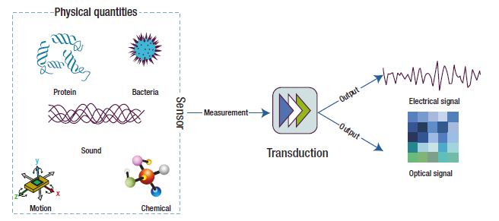
What is a sensor?
A device that receives a stimulus and responds with an electrical signal.
A special type of transducer (device that converts one type of energy into another

Slide 51
Common Sensors
Mechanical
  Accelerometers: measure acceleration forces
  Gyroscopes: useful for measuring or maintaining orientation.
Optical
  Photodetectors: Detect light
  Infrared: emitting and/or detecting infrared radiation
Semiconductor
  Gas
  Temperature
  Magnetic

Slide 52
Sensors to be used in Buggy
Infra Red (IR) Sensor
Ultrasonic Sensor
Pulse Receiver
ZigBee module (For inter buggy and Command centre communication)

Slide 53

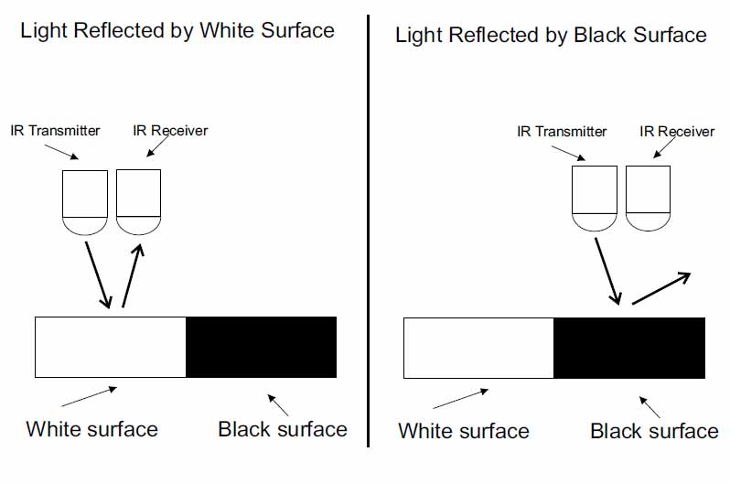

Slide 54
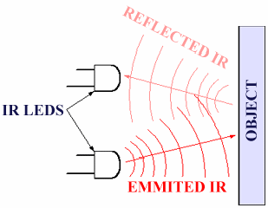

Slide 55

IR-LED – Tx
PD – Rx

Slide 56

IR-LED work similar to normal LED
IR-LED transmit infrared light
IR light is not visible to our naked eye
IR light is detected by Photodiode

Slide 57

How PD work ?
PD generate the voltage depending on the intensity of light

Slide 58

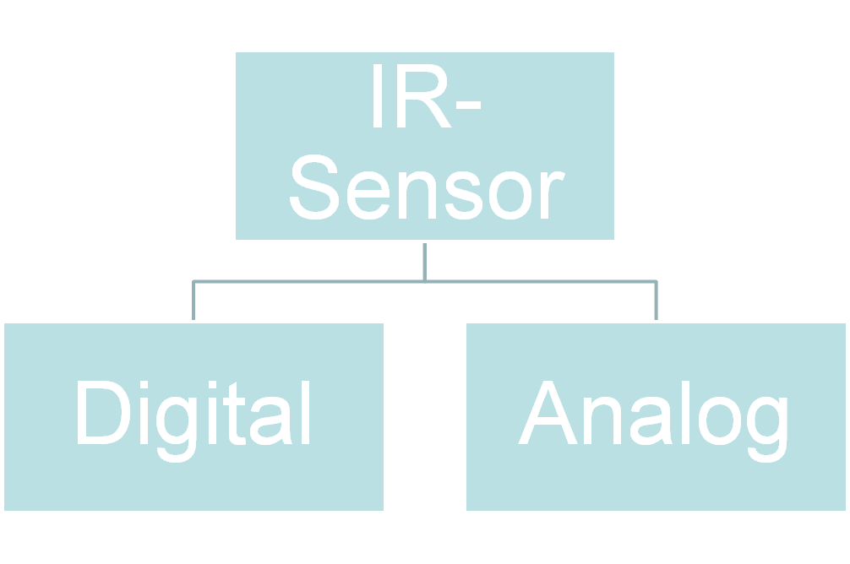

Slide 59
Digital – In digital sensor output is digital (High or Low).
Analog – In analog sensor detection depend on intensity of light received.

Slide 60

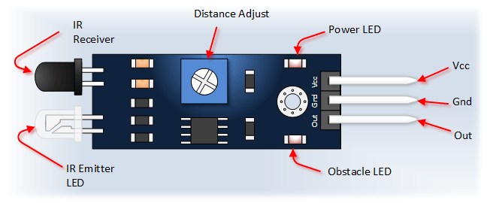
In some module output is middle pin while in other its sideline pin. Extra caution
is required to attach these pins to Arduino.

Slide 61

int r1;
int r2;
int r3;
int r4;
void setup() {
Serial.begin(9600);
pinMode(A1,INPUT);
pinMode(A3,INPUT);
}
void loop() {
r1=analogRead(A1);
r2=analogRead(A3);
r3=digitalRead(A1);
r4=digitalRead(A3);
Serial.println(r1);
Serial.print("\t");
Serial.println(r2);
Serial.print("\t");
Serial.println(r3);
Serial.print("\t");
Serial.println(r4);
}

Slide 62
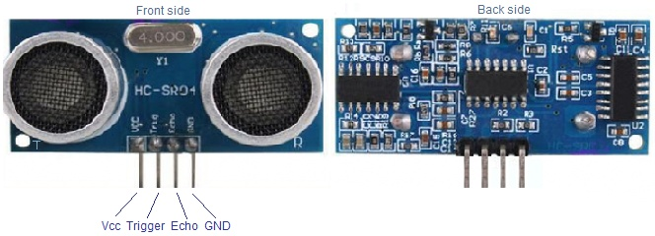
ULTRASONIC SENSOR
It is essential to give your robot eyes for preventing crashes. Ultrasonic sensors, also known as transducers, have a similar working system as a radar or sonar by interpreting the echoes of radio or sound waves generated by the sensor. In this way, a robot can detect obstacles and the distance to obstacles. In this article, we make an overview of most popular ultrasonic sensors used in robotic applications and tutorials to learn how to interface and programming these sensors in order to build robots.

Slide 63
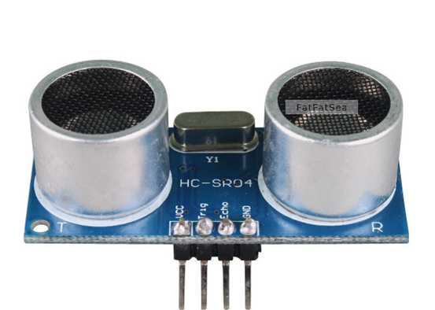
Hcsr04 ultrasonic sensor
Pin description:
VCC – 5V, +ve of the power supply
TRIG – Trigger Pin
ECHO – Echo Pin
GND – -ve of the power supply

Slide 64
HC-SR04 provides measurement function between 2 and 400 centimetres at range accuracy of 3 millimetres. The HC-SR04 module hosts the ultrasonic transmitter, the receiver and control circuit.
The HR-SR04 has four pins namely Vcc, Trigger, Echo, GND and they are explained in detail below.
1) VCC: 5V DC supply voltage is connected to this pin.
2) Trigger: The trigger signal for starting the transmission is given to this pin. The trigger signal must be a pulse with 10uS high time. When the module receives a valid trigger signal it issues 8 pulses of 40 KHz ultrasonic sound from the transmitter. The echo of this sound is picked by the receiver.
3) Echo: At this pin, the module outputs a waveform with high time proportional to the distance.
4) GND: Ground is connected to this pin.

Slide 65
Working principle
firstly, transmit at least 10us high level pulse to the Trig pin (module automatically sends eight 40K square wave) .
then wait to capture the rising edge output by echo port, at the same time, open the timer to start timing.
Next, once again capture the falling edge output by echo port, at the same time, read the time of the counter, which is the ultrasonic running time in the air.

Slide 66
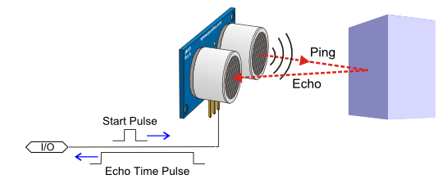
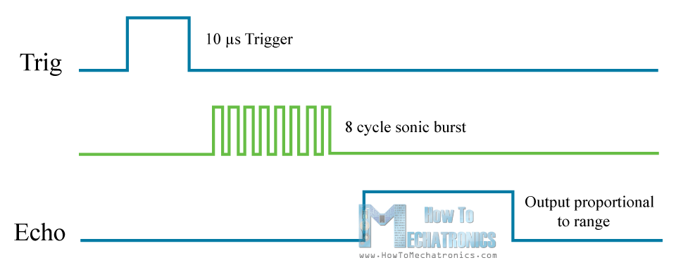
Working principle

Slide 67
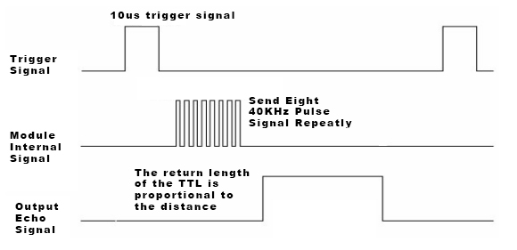
Working principle

Slide 68
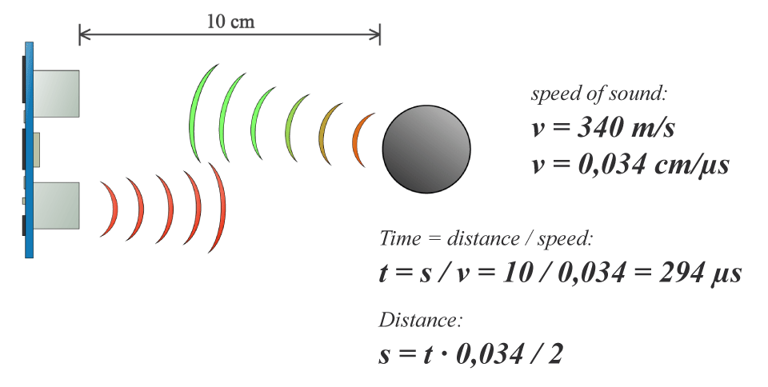
Calculate Distance to Obstacle

Slide 69
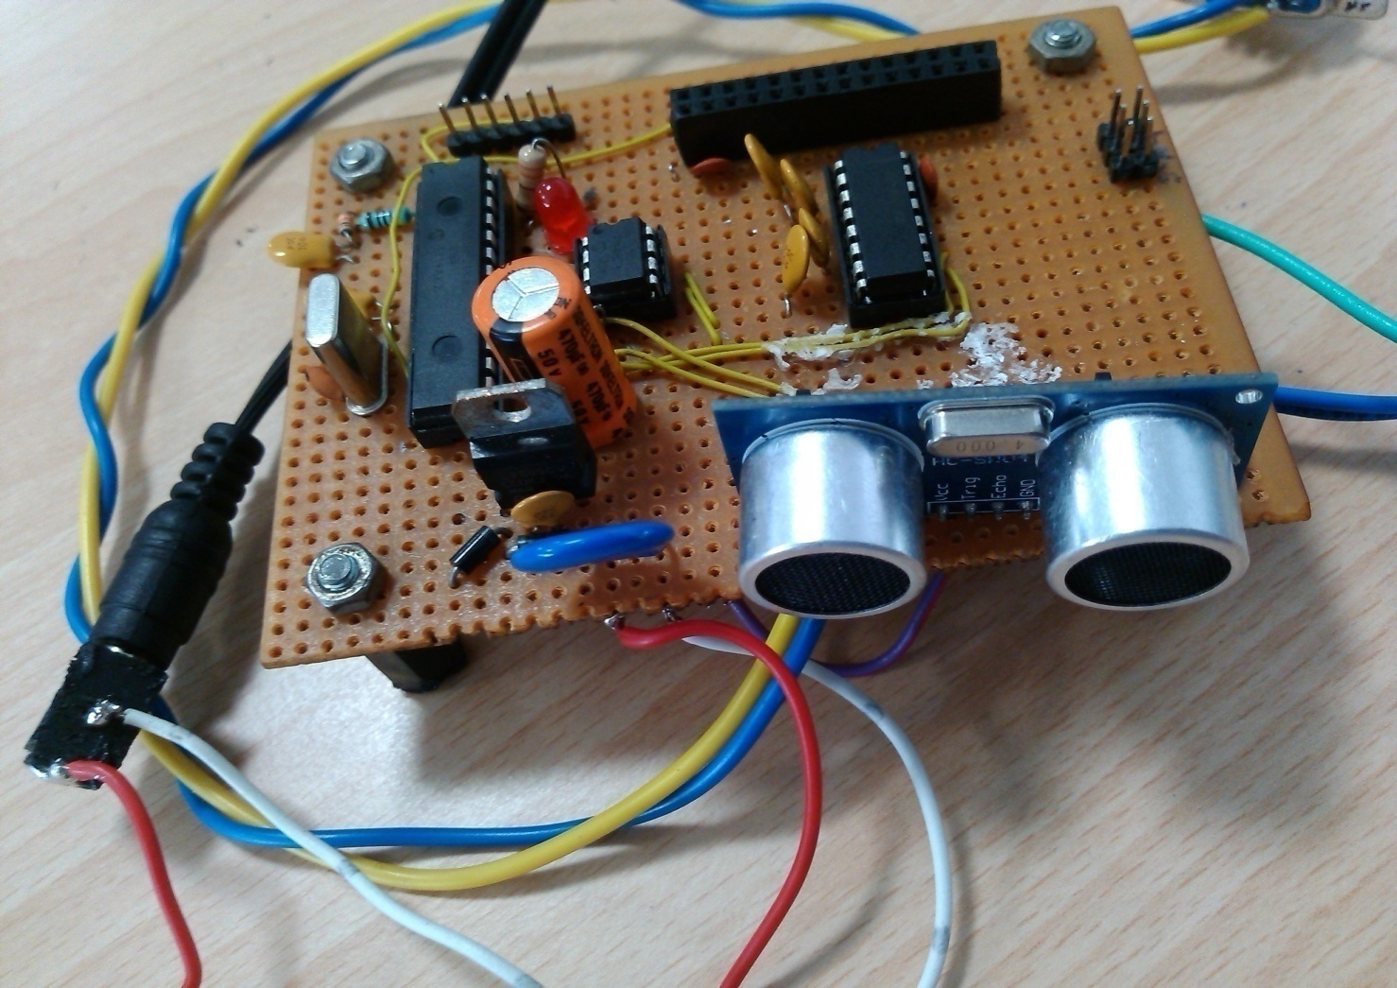
PIC18F26K80 DEVELOPMENT BOARD

Slide 70
Ultrasonic Sensor Example (1/2)
const int trigPin = 13;
const int echoPin = 12;
long duration;
int distanceCm, distanceInch;
void setup() {
pinMode(trigPin, OUTPUT);
pinMode(echoPin, INPUT);
Serial.begin(9600);
// initialize digital pin motor as an output
pinMode(5, OUTPUT); // Right +ve)
pinMode(6, OUTPUT); // Right -ve
pinMode(7, OUTPUT); // Left -ve
pinMode(8, OUTPUT); // Left +ve
}

Slide 71
Ultrasonic Sensor Example (2/2)
void loop() {
int s=0;
digitalWrite(trigPin, LOW);
delayMicroseconds(2);
digitalWrite(trigPin, HIGH);
delayMicroseconds(10);
digitalWrite(trigPin, LOW);
duration = pulseIn(echoPin, HIGH);
distanceCm= (duration*0.034)/2;
distanceInch = (duration*0.0133)/2;
Serial.println(distanceCm);
if(distanceCm<30) //here we set the object range 15cm.
{
Put your code here
}

Slide 72
Code using NewPing library
#include <NewPing.h>
#define TRIGGER_PIN 13
#define ECHO_PIN 12
#define MAX_DISTANCE 200
NewPing sonar(TRIGGER_PIN, ECHO_PIN, MAX_DISTANCE);
void setup() {
Serial.begin(9600);
}
void loop() {
delay(50);
Serial.print("Ping: ");
Serial.print(sonar.ping_cm());
Serial.println("cm");
}

Slide 73
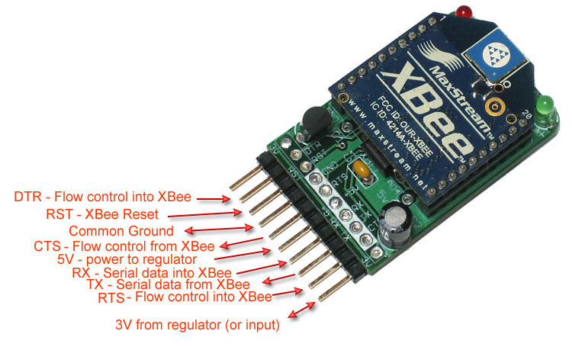
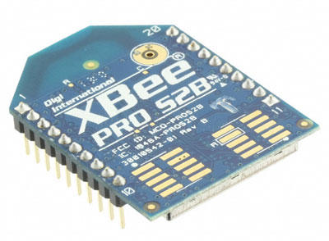
ZigBee Technology
The explosion in wireless technology has seen the emergence of many standards, especially in the industrial, scientific and medical (ISM) radio band. There have been a multitude of proprietary protocols for control applications, which bottlenecked interfacing. Need for a widely accepted standard for communication between sensors in low data rate wireless networks was felt.

Slide 74

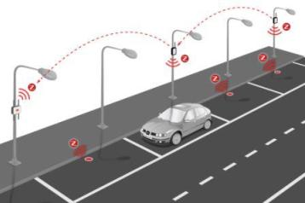
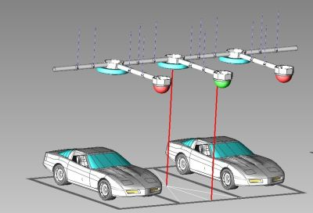

Slide 75
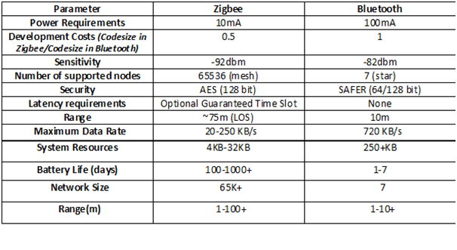
Comparision Between Zigbee and Bluetooth

